Slide 1

OLAF
Aurélien FERNANDEZ
Online Automated Farm
Notes:
This is when OLAF came in my mind, OLAF is an online automated farm

Slide 2

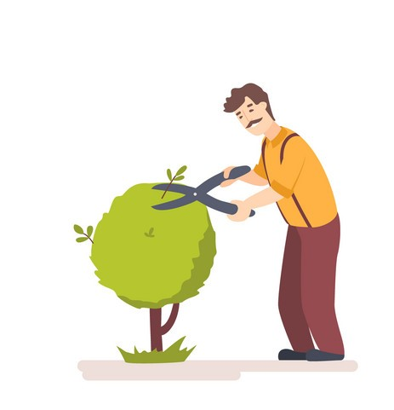
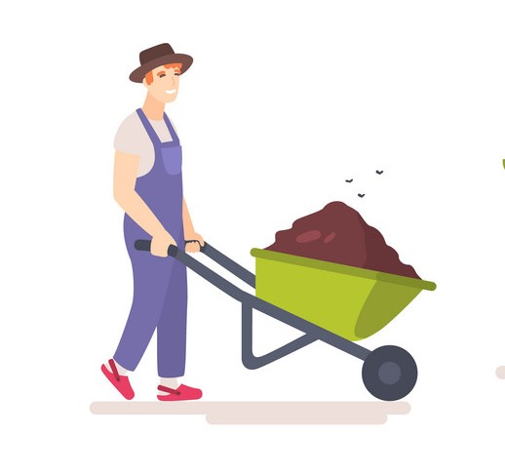
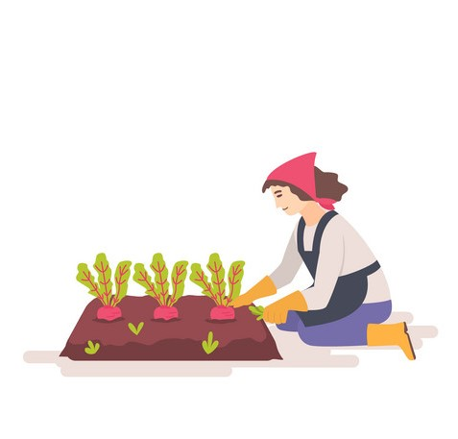


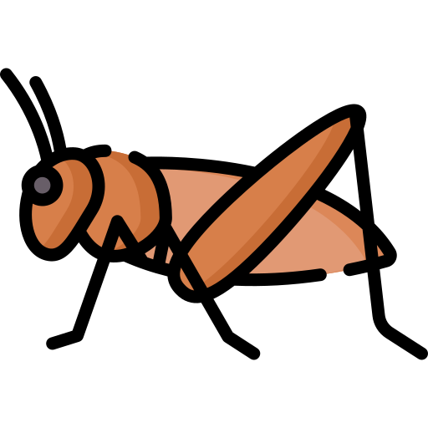
The origin
Notes:
64% of people in FR take care of plants, either in plant pot, garden or community garden
How can I help them?
Climate change - variations can go up to a 20°C difference in less than a week
Infections - difficulties to identify and to treat

Slide 3
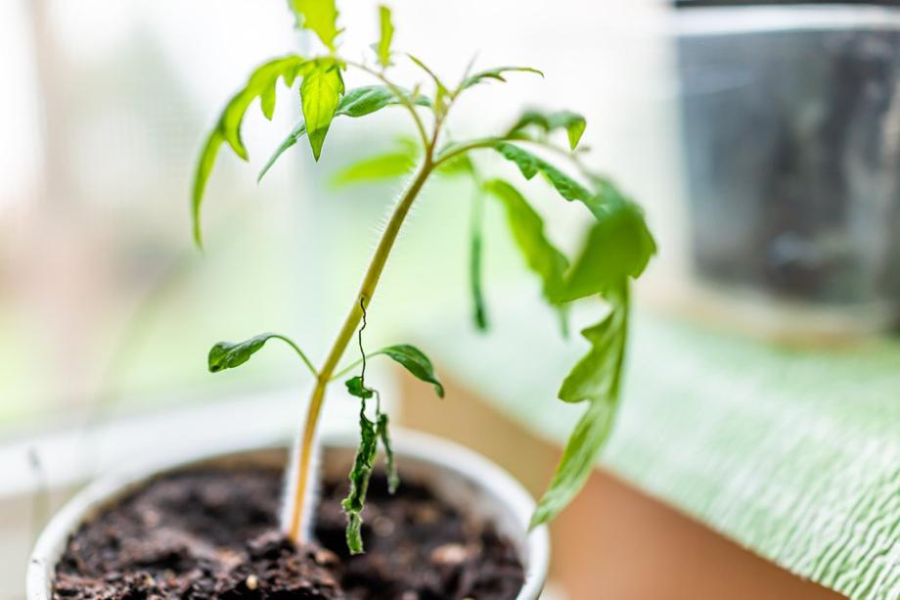
01. For Whom ?
Notes:
Before explaining further, let’s see who could be in need of such thoughts.

Slide 4
Target audience
United states
89% ~293,255 Million
France
64%
~43.129 Million
Notes:
Show the potential target in FR, and take US as example in case of internationalization

Slide 5
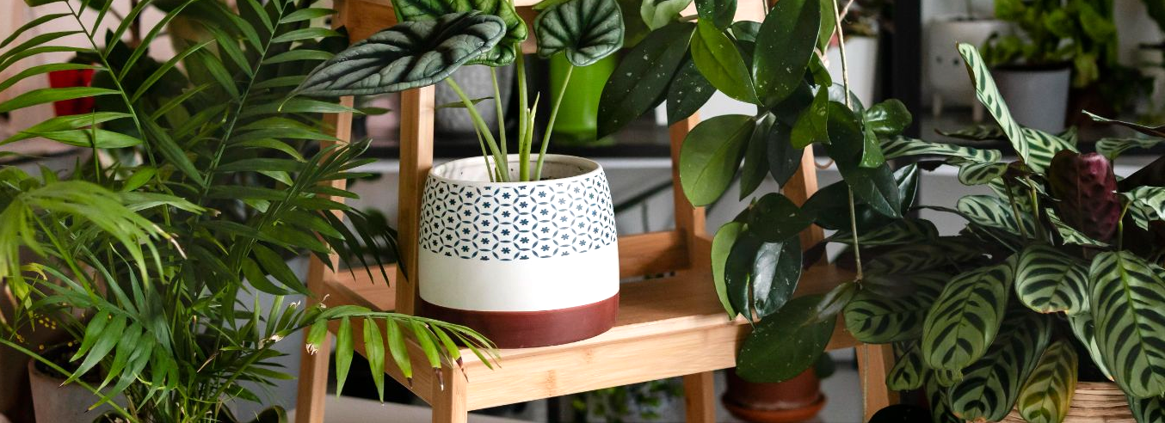
The initial idea
02

Slide 6
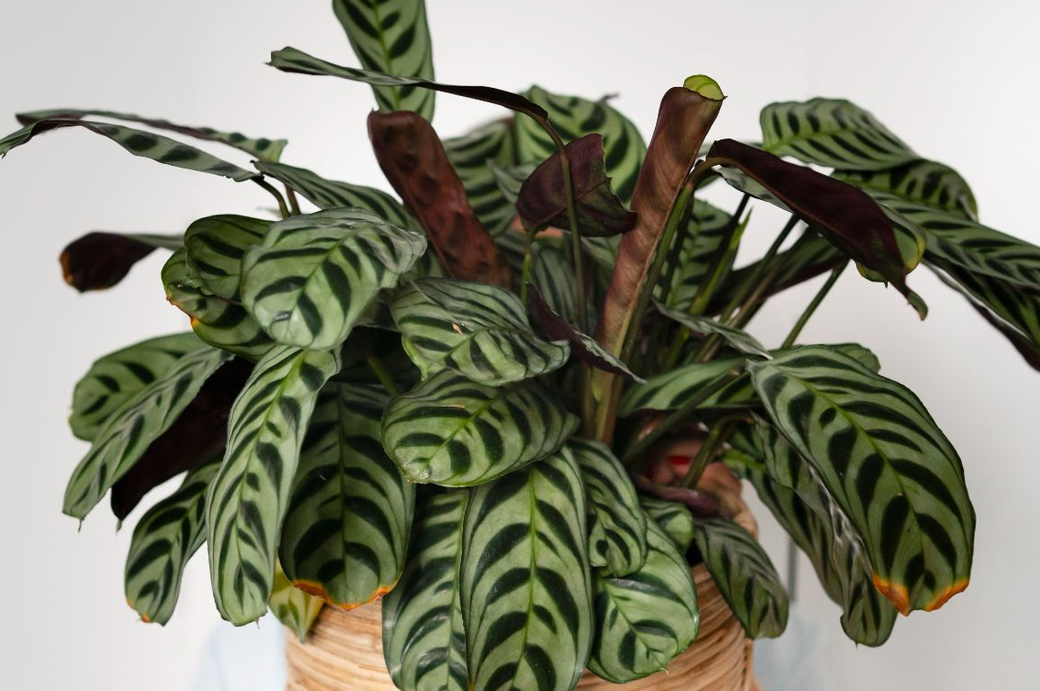
An embedded system
A mobile app
Managing and monitoring a plant
Manage and check the status of your plants

Slide 7

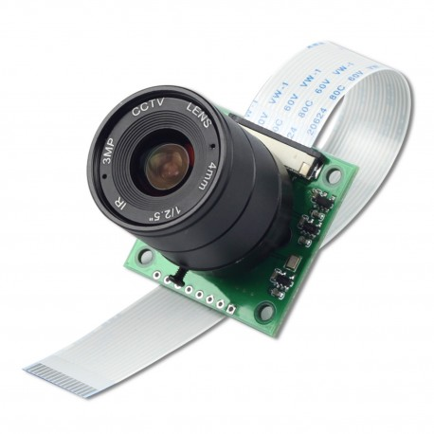
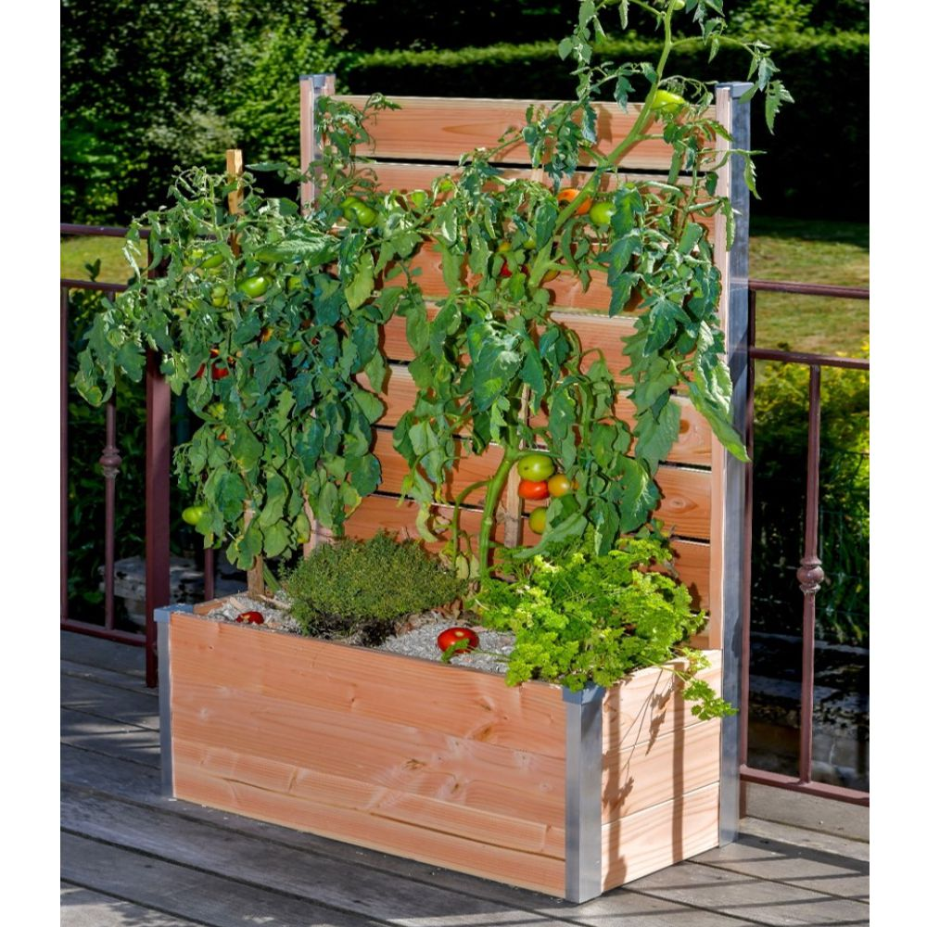
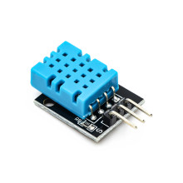
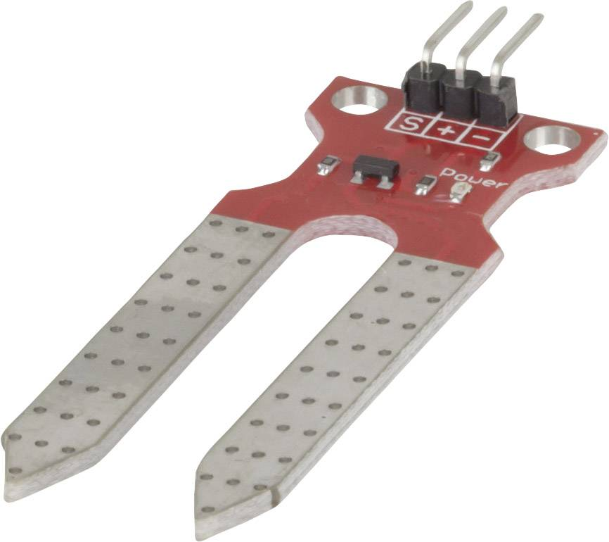
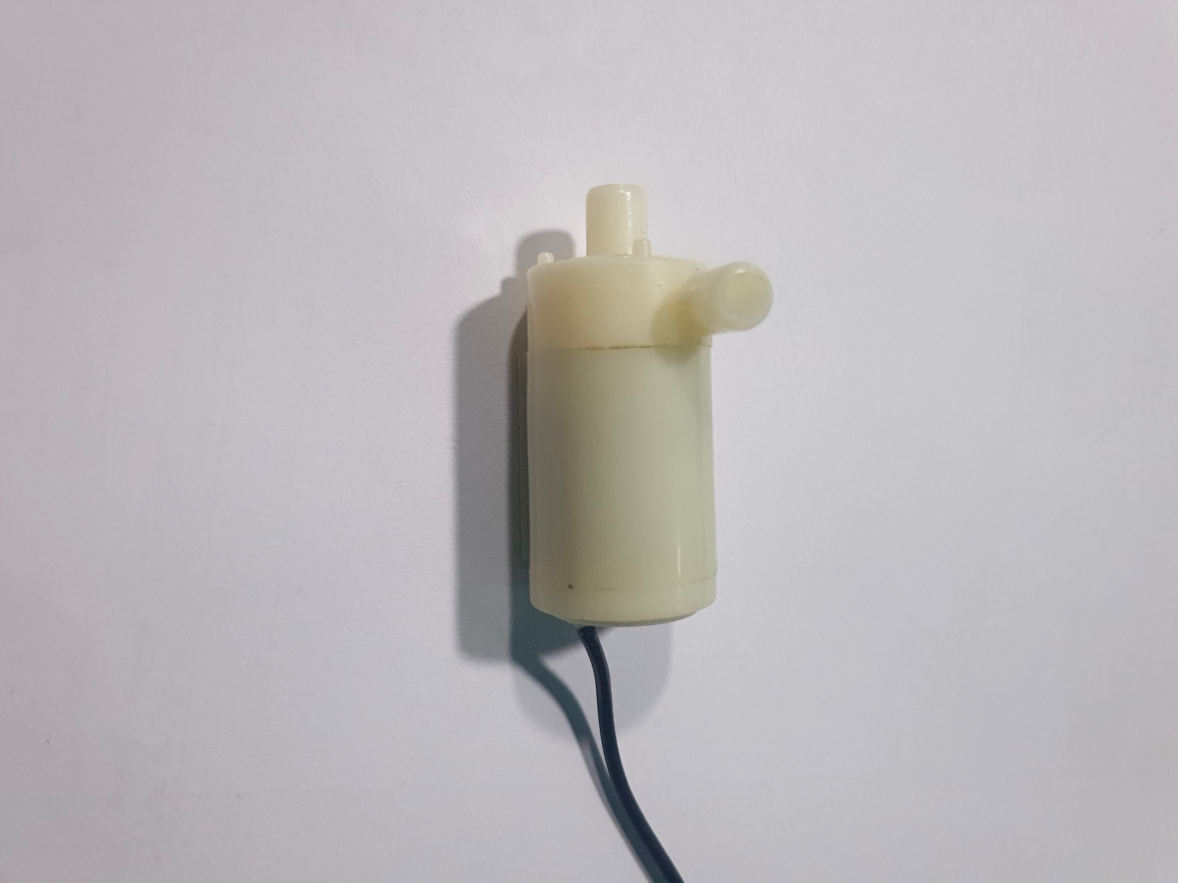
Notes:
Present the idea of a plant pot able to identify and manage the plant

Slide 8

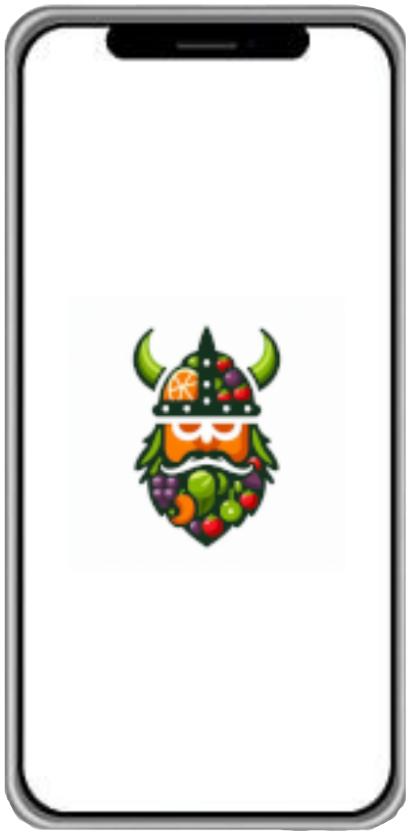
Notes:
The plant pot is directly connected to the phone and both phone and plant pot communicate to a server, to manage to which user the pot is connected to

Slide 9


React native
- Android & IOS
- Single codebase
Firebase
- Relatively cheap
- Scalable
Notes:
Present react and firebase

Slide 10
A failure
01
02
03
No defined scopes
Bad management
Technical problems
Notes:
Unclear objectives
Badly managed time and the order of tasks to follow
React problems with the computer

Slide 11
The final idea
03

Slide 12
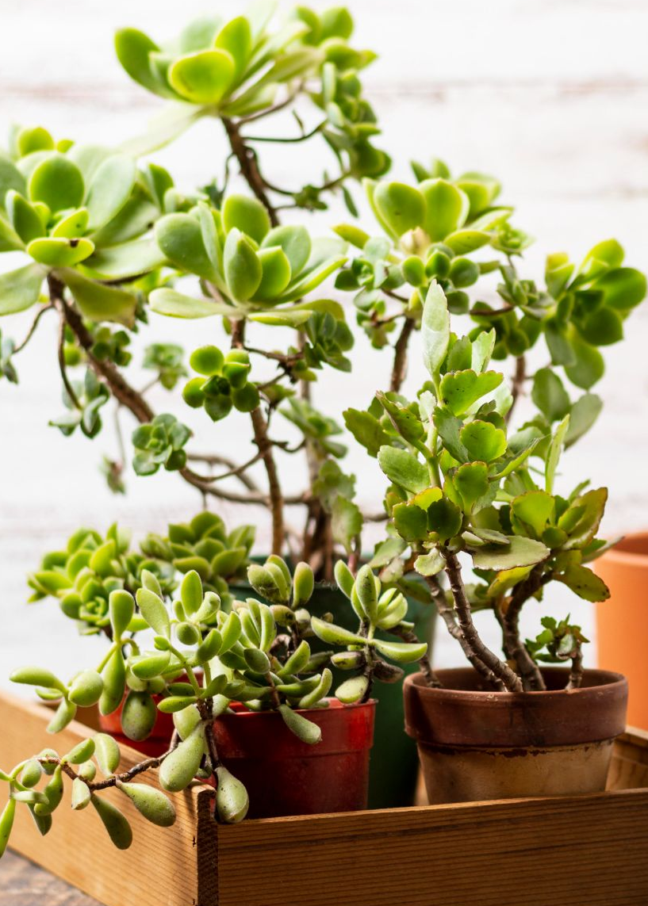
An embedded system
Backend services
A mobile app
Managing and monitoring a plant
NEW
User pool, lexicon versioning
And image processing
Manage and check the status of your plants
Notes:
Present the same objectives but with the backend that is now far more important

Slide 13
Notes:
Briefly explain how the elements communicates from the plant pot, to the server and how the app and server communicates

Slide 14

Notes:
Explain how that now, the plant pot became secondary and the app primary for the project, and it allows the creation of a administration system

Slide 15
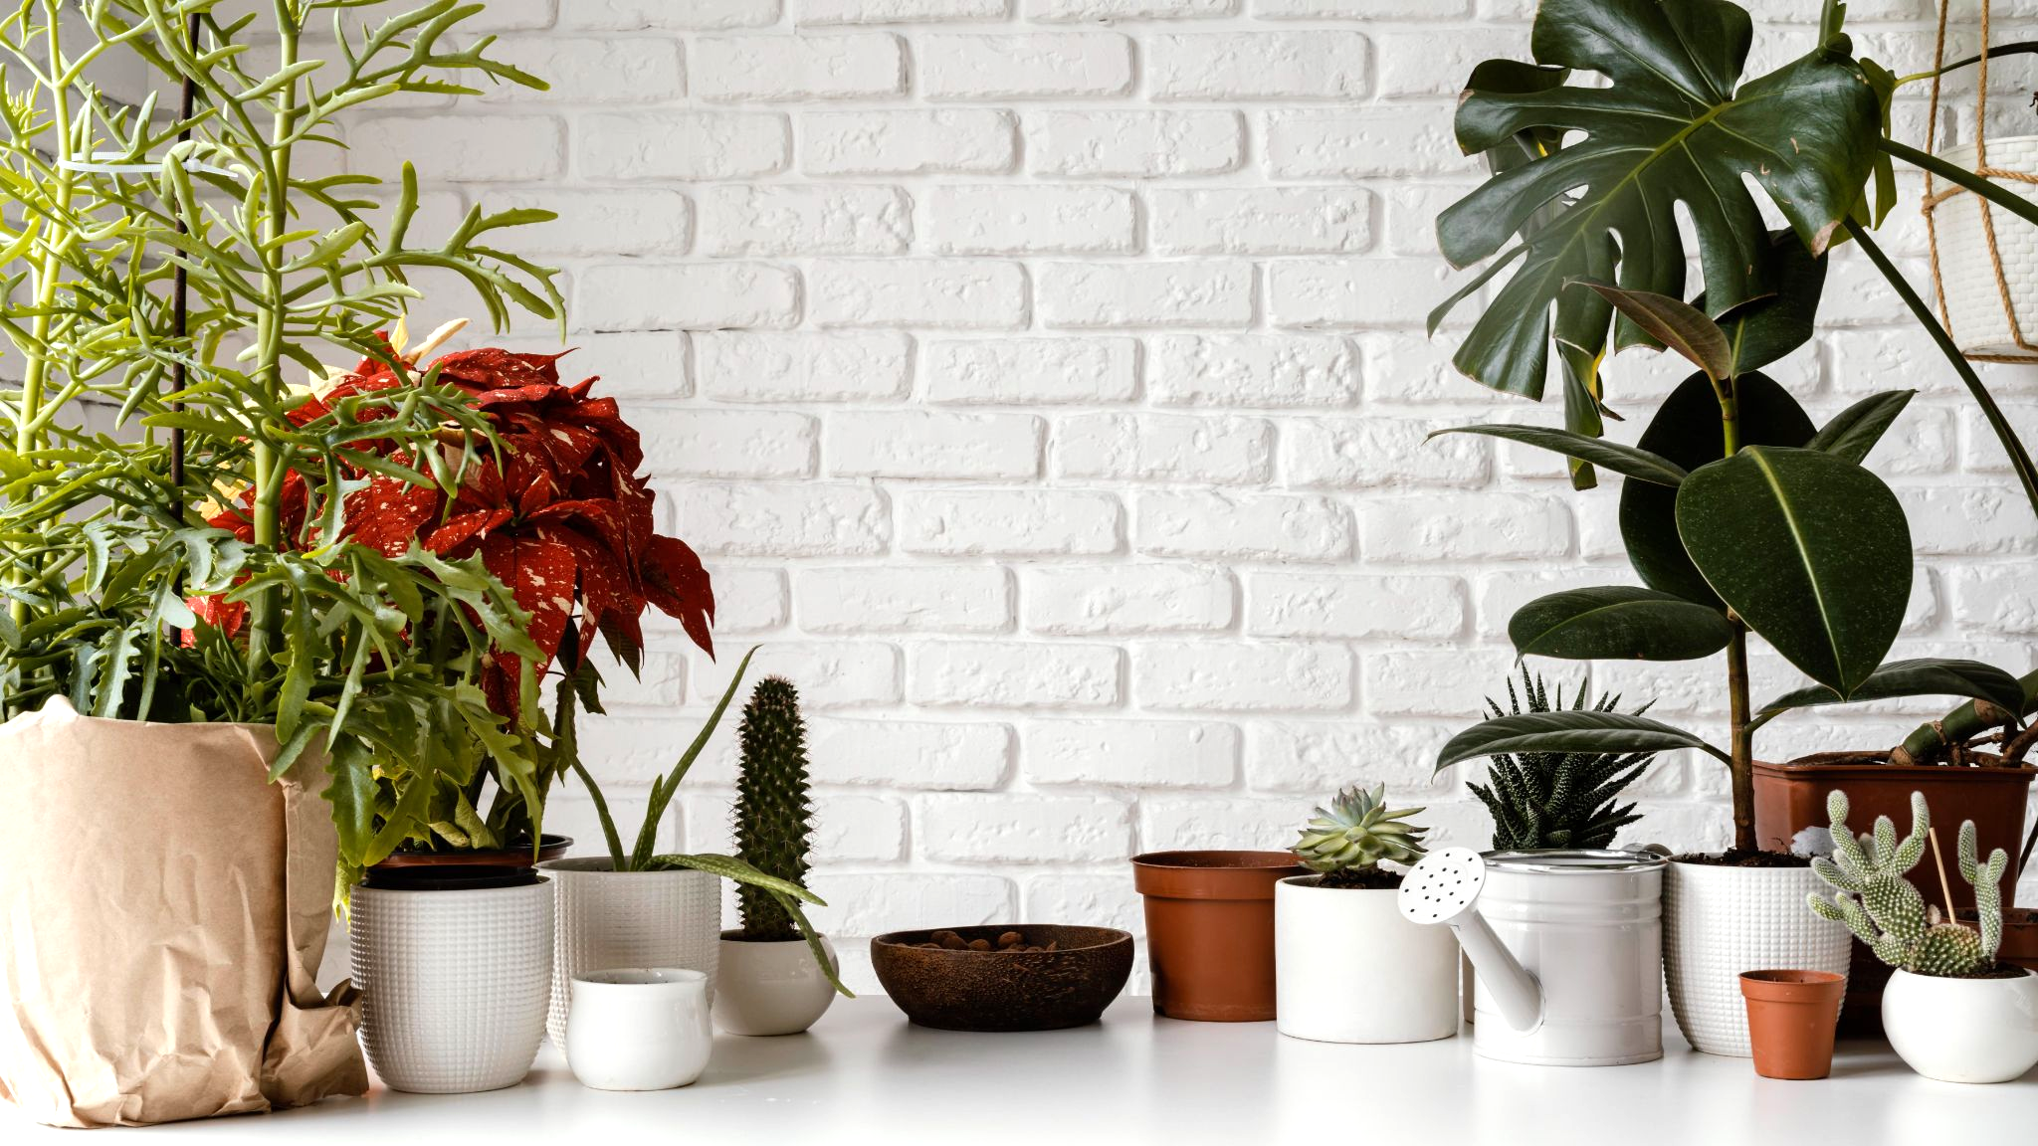
How Does it works
04

Slide 16




Aws
Flutter
AI
Raspberry
To store, process and transfer data
To create the mobile and the web app
To detect diseases from leaves
To create the intelligent plant pot
Notes:
Briefly show what I am using and in which order I will present the different tools

Slide 17
Amazon web services
Services provider
Multiple tools
Fast
Notes:
Present aws

Slide 18

A special help
PME - ~50 employees
ESN - creates projects and offer consulting
Notes:
Present komet and what they provide

Slide 19
A special help
An AWS developer account
Access to most if not all resources
30 € budget per month
Notes:
Present komet and what they provide

Slide 20


A special help
Notes:
In exchange for the AWS services, I have to present this project in front of Komet’s engineers, of course a more technical version of this presentation.

Slide 21




Amazon web services
3 lambdas
1 S3
1 dynamodb
Cognito
lexica-update
ai-update
image-analyzer
olaf-s3
olaf-lexica
olaf-userPool
Notes:
Explain what is each services and how I use them

Slide 22
AWS cost
Currently
Expected
0.07 € / month
Under free tier
~18.96 € / month
Next year with the current configuration
Notes:
What is the current cost of AWS and how we can expect it with hundreds of users

Slide 23
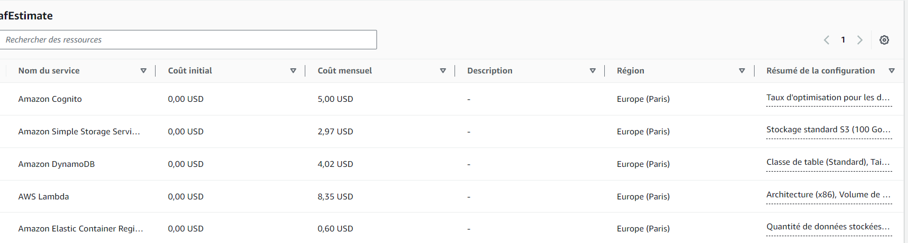
AWS cost
100 users and 100 000 request on each services
Notes:
What is the current cost of AWS and how we can expect it with hundreds of users

Slide 24
Flutter
Android, IOS, Web apps, etc
Single codebase
Faster than react
Notes:
Explain what is flutter and dart and why I changed from react to flutter

Slide 25

Resnet V2
Residual network
Well known for image classifications
Notes:
Residual network means output = input + transformed input.
Restnet is commonly used for image classifications, object detections, video analysis, increasing image resolution etc, so mainly tasks involving images
Highly performant in ImageNet

Slide 26

Plantvillage & a few more
Tomato, 9 diseases
Raspberry, 1 disease
Potato, 2 diseases
Pepper bell, 1 disease
Raspberry, only healthy for now

Slide 27

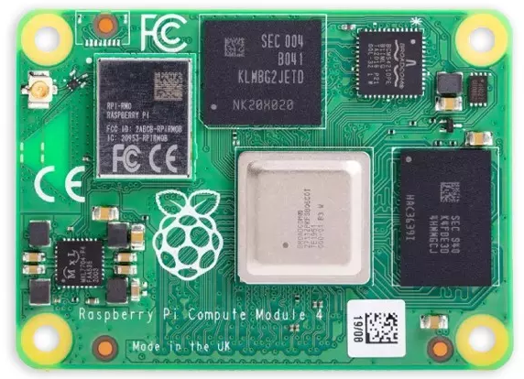
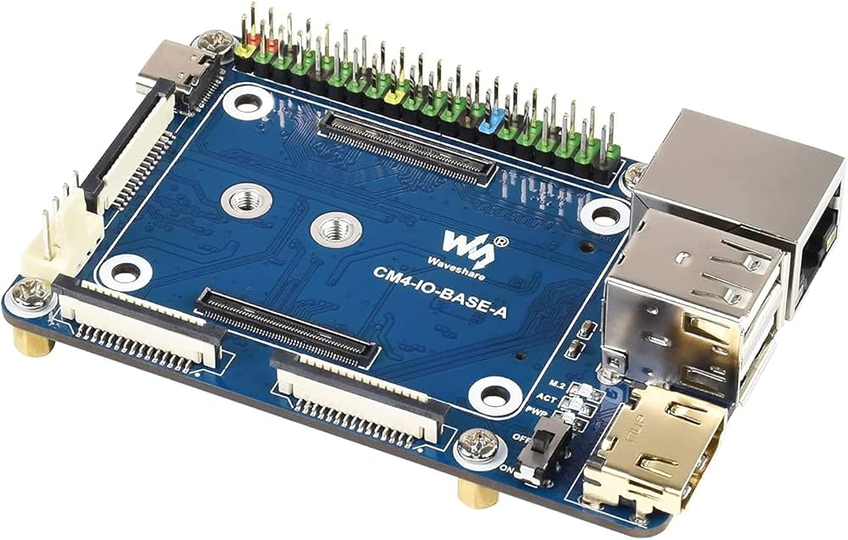
Raspberry
Notes:
Explain what is raspberry and why a compute module 4

Slide 28
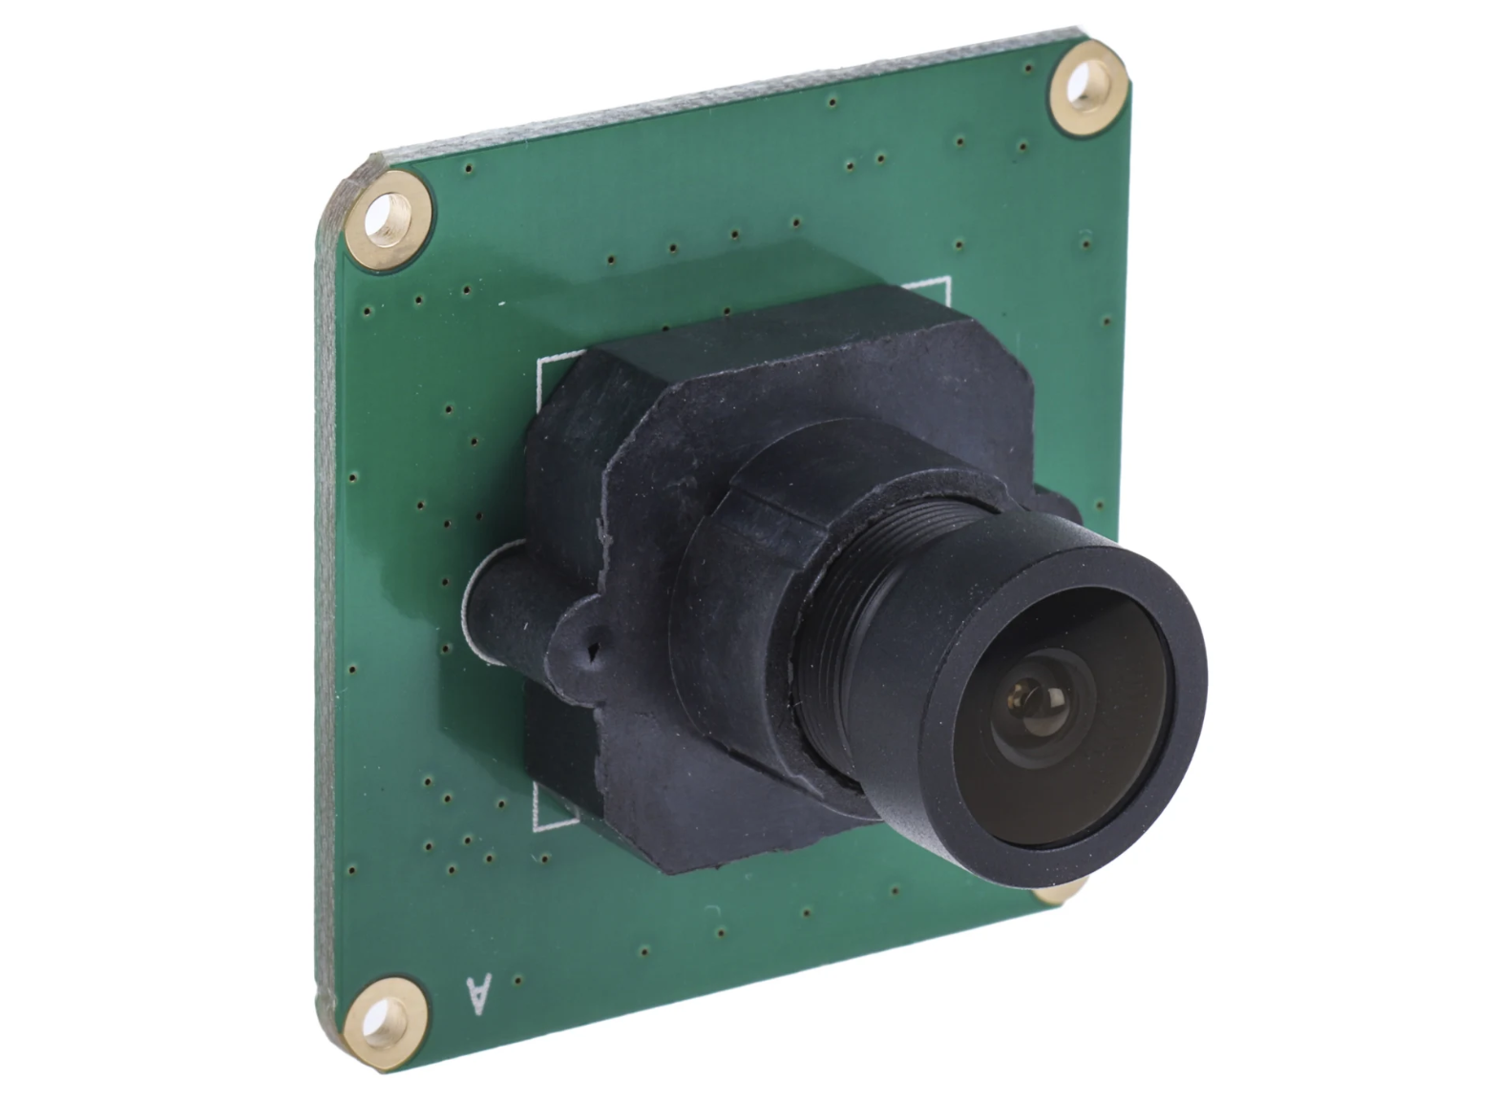
Raspberry
OKDO 5MP
Adafruit water pump
DHT22 & moisture sensor
Notes:
Camera: 5mp from Okdo
Temperature: DHT-22
Humidity : soil moisture sensor from az-delivery
Water pump: submersible water pump from adafruit

Slide 29
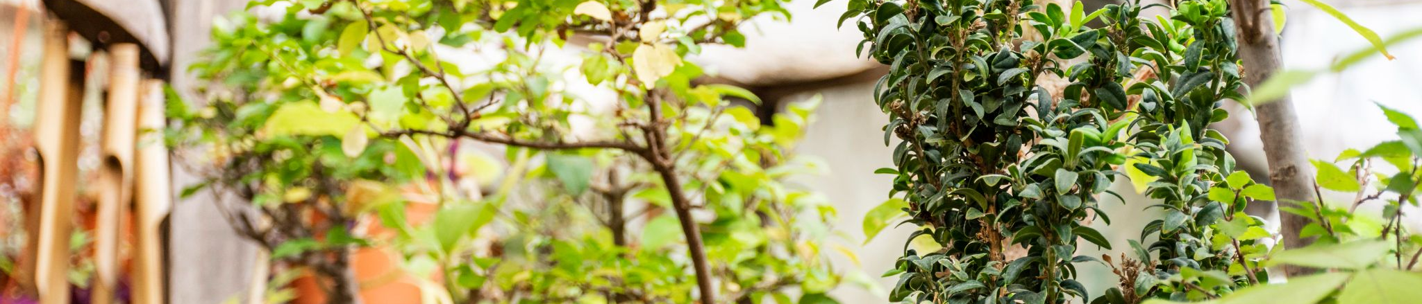
Conclusion
04

Slide 30
Scopes achieved
Notes:
The success rate of the AI (on trained data) and the app is finished

Slide 31
Feedbacks
Positives
The app is easy to use
The lexicon is a good feature
Negatives
The AI can’t identify non-plants objects
The camera’s background feels off
Notes:
Explain the different feedbacks
Explain that the AI’s results, due to its architecture, tends to 0% instead of the 95%

Slide 32


Improvements
Neural network
Bayesian network
Notes:
Switch from a neural network to a bayesian network, which takes doubt/biases into account
Finish the admin web app
Finish the embedded system

Slide 33
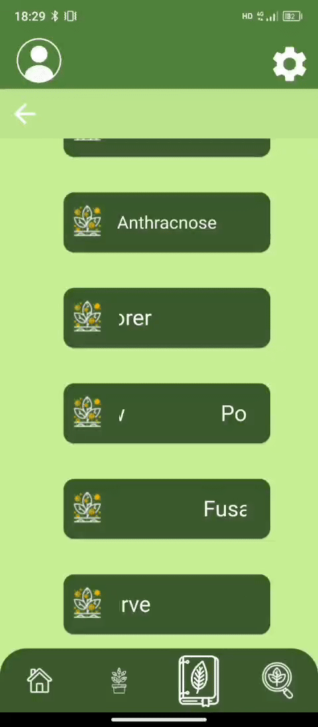
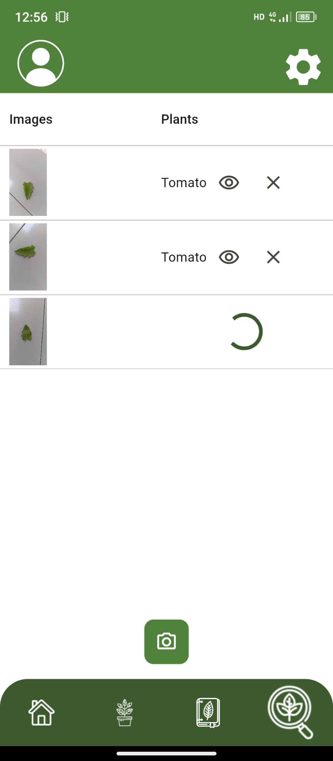
Improvements
Notes:
Change the background and the sliding text

Slide 34
05
Retrospective
Notes:
Conclude by describing how I experience this project, what I learned etc

Slide 35
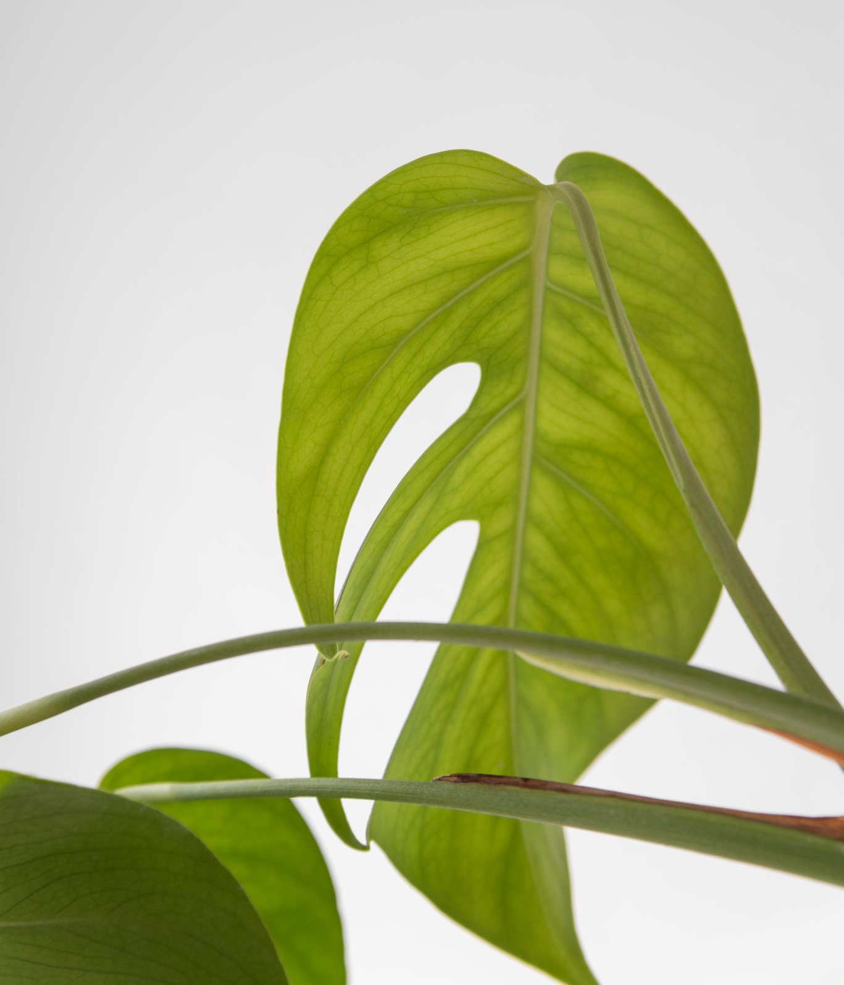
THANKS!
Do you have any question?
Please keep this slide for attribution

Slide 36
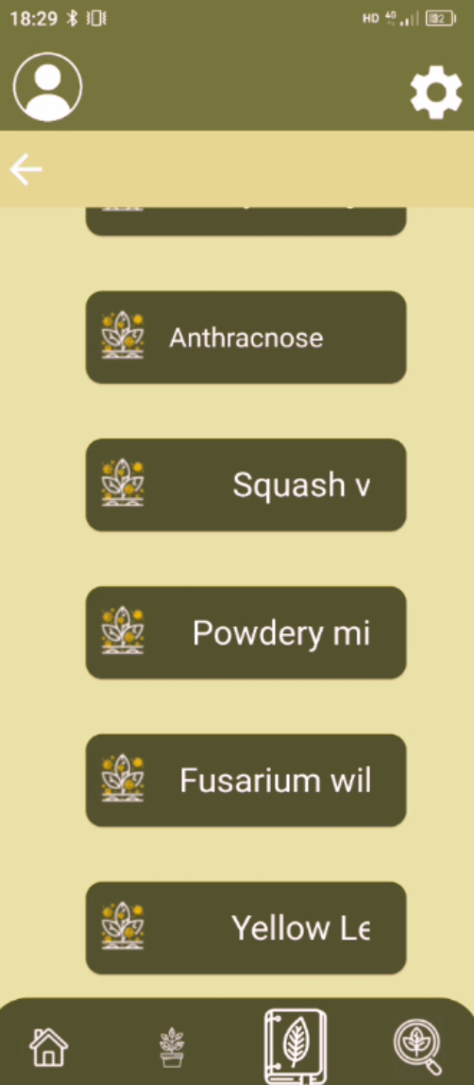
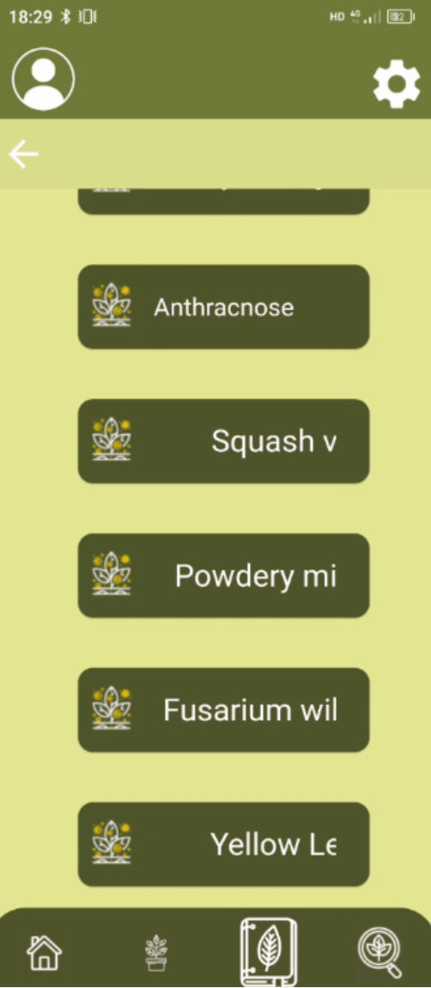
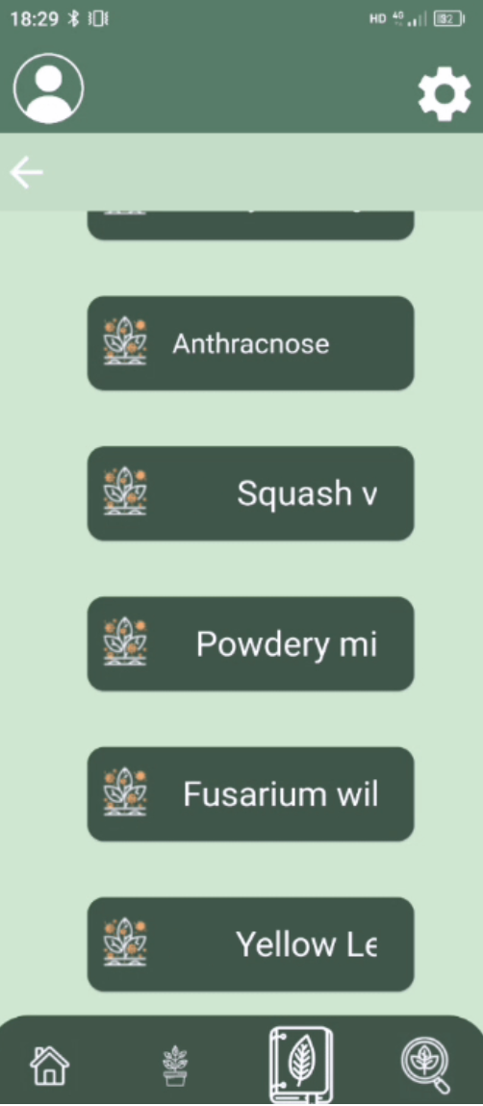
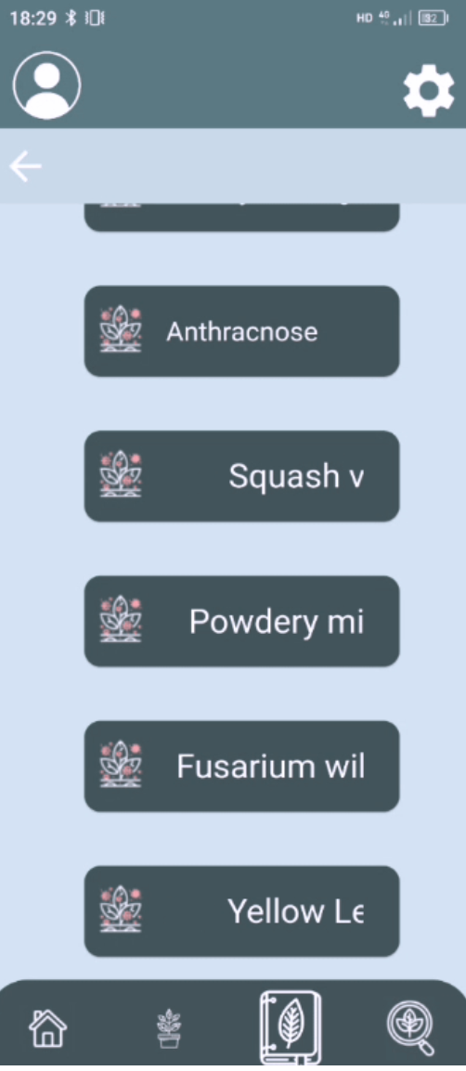
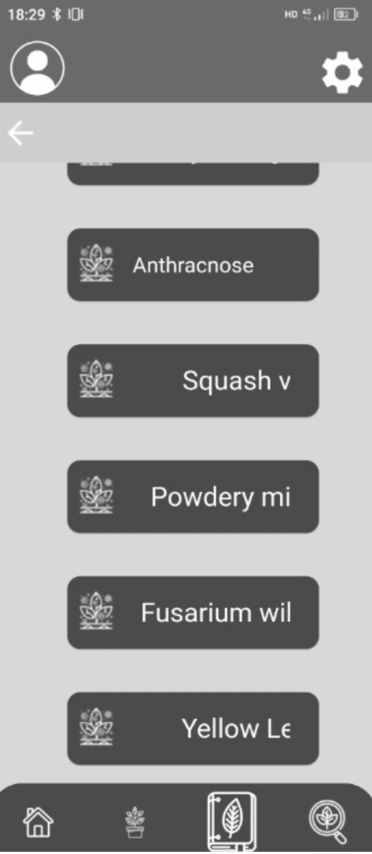
Color blindness

